Slide 1
Formal Methods Lec#2-Ver3
By: Dr. Sarmad Sadik

Slide 2


Natural Deduction
Transitive rule
(p→ q),(q→ r), We can conclude (p→r)
Modus Tollens

Slide 3
Example
If a baby is hungry, then the baby cries. If the baby is not angry, then he does not cry. If a baby is angry, then he has a red face. Therefore, if a baby is hungry, then he has a red face.
Model this problem!!
h: a baby is hungry
c: a baby cries
a: a baby is angry
r: a baby has a red face
h c
~a ~c
a r
. . . h r

Slide 4
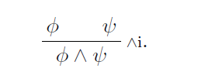
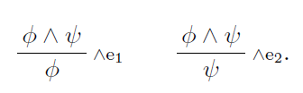
Natural deduction
Rules for conjunction

Slide 5

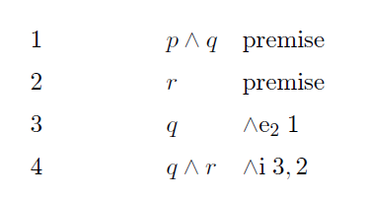
Natural deduction

Slide 6

Natural deduction
Rule of double negation

Slide 7
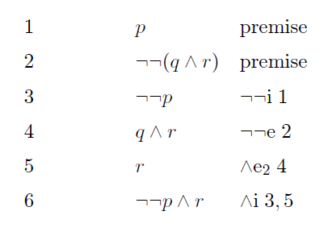
Natural deduction

Slide 8
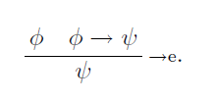

Natural deduction
Rule for eliminating implication

Slide 9
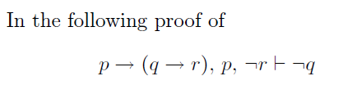
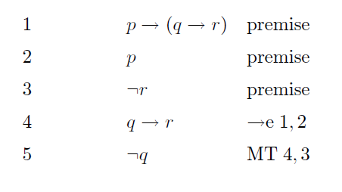
Natural deduction

Slide 10
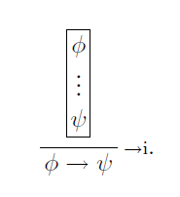
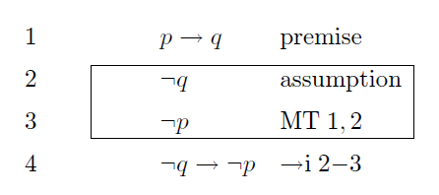
Natural deduction
Rule for implies introduction

Slide 11
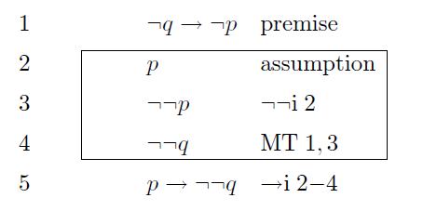
Natural deduction

Slide 12
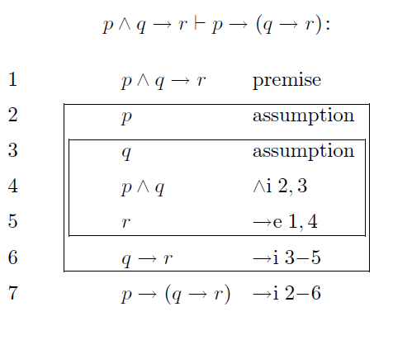
Natural deduction

Slide 13

Natural deduction
Rules for Disjunction

